Slide 1
Configuration Management with Azure Automation DSC
Cloud & On-Premises, Windows & Linux
Ed Wilson @Scriptingguys
OMS Team
Notes:
Joe

Slide 2
Session Objectives And Takeaways
Session Objective(s):
Provide an overview of Azure Automation
Demonstrate heterogeneous IT management using PowerShell and PowerShell DSC in Azure Automation
Key Takeaways
Azure Automation provides PowerShell as a Service -- a central, secure location for all your PowerShell assets, executions, and reports, that is scalable, reliable and highly-available
  Azure Automation DSC provides a reliable, highly-available, scalable DSC pull and reporting service that can be used to deliver, monitor, and update infrastructure aligned with IT rules
  Azure Automation simplifies automation and configuration across clouds, platforms, and datacenters
Notes:
Joe

Slide 3
The Problem*
“Keeping the 1000s of servers running my services configured correctly is incredibly complicated and error-prone.”
*This is just one of many IT management problems Azure Automation can solve
Notes:
Ed

Slide 4
The Problem – In Detail
  Many servers to configure, in various “roles”
  More servers to configure as infrastructure scales to meet applications’ capacity demands
  Servers within a role need to be configured exactly the same
  Servers in different roles configured differently
  Other employees, and internal software, have access to these VMs and may change things
  As applications’ demands change, configurations must be updated to support these changes
  Different teams responsible for different “pieces” of the configurations
Notes:
Ed

Slide 5
Azure Automation Overview
Notes:
Joe

Slide 6
Process & desired state automation that simplifies cloud & on-premises management
Optimize and extend existing investments
  Integration
  Integrate into existing systems & components with PowerShell modules and DSC resources
  Build additional PS modules to enable integrating into other systems / components
Deliver flexible and reliable services
  Orchestration
  Accelerate time to value with flexible workflows & declarative configurations
Improve service reliability across multiple tools, systems, and department silos
Lower costs and improve predictability
  Automation
Enable service owners to focus on work that adds business value
Reduce error-prone manual activities while lowering costs
Ensure new and existing systems stay in the correct state
Notes:
Joe

Slide 7

Operations Management Suite
Containers
Analytics | Automation | Recovery >>
Wire Data
Configuration
Linux
Inventory
Operations
Management Suite
CMDB
Patching
Remote OS Management
Alerting
Security | Update | Change | Dashboards >>
Microsoft Operation Management Suite
Notes:
Joe

Slide 8
PowerShell++
Centralized, secure store
Highly Available, Scalable, Manageable
PowerShell
Runbooks - PowerShell scripts that automate complex, end-to-end processes
Historical Analysis
View runbook version used for each job
Historical view of runbook job executions
PS DSC Pull / Reporting server
Execution environment for PowerShell
Schedules
Draft / published versions
PS Modules / PS DSC resources
Connections
Variables
Credentials
Certificates
Configurations – PowerShell DSC Configurations to enforce how machines should be configured
REST API, C# SDK, cmdlets, and portal for managing all aspects of the service
High-level & granular views of DSC node compliance, now and in the past
PowerShell
Centralized, secure store
Microsoft Azure Automation
Highly Available, Scalable, Manageable
Historical Analysis
Notes:
Joe

Slide 9

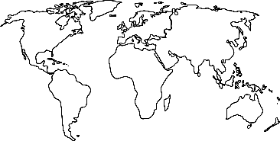
PowerShell, as a service
Simplicity
Automate with no installation required
No infrastructure to maintain
Free tier lets you ‘try before you buy’
Velocity
Scale instantly, as your needs change
Get new features frequently & automatically
Ubiquity
Multiple regions, for policy compliance & DR
Integrate ‘behind the firewall’ on-premises
Notes:
Joe

Slide 10
Automation Features
Runbook Gallery
Module Gallery
  PowerShell script runbooks
PowerShell v5 support
Side by side module versioning
PowerShell classes
PSWF improvements
New cmdlets (Convert-String)
PS DSC improvements (PSRunAsCredential)
  PowerShell ISE Add-On
Hybrid Worker
Graphical Authoring
  Azure Automation DSC
  Source Control support
  OMS Log Analytics & Azure Alerts integration
  Enable automation runbooks to be triggered from OMS Log Analytics or Azure alerts
  Diagnostic Logs
  Job Stream/Operational Logs -> Customer’s Storage Account
  AzureRM modules shipping in the service
  Automation UX goes GA in the new Azure portal
  Hybrid worker “run as”, webhook support
Notes:
Joe

Slide 11
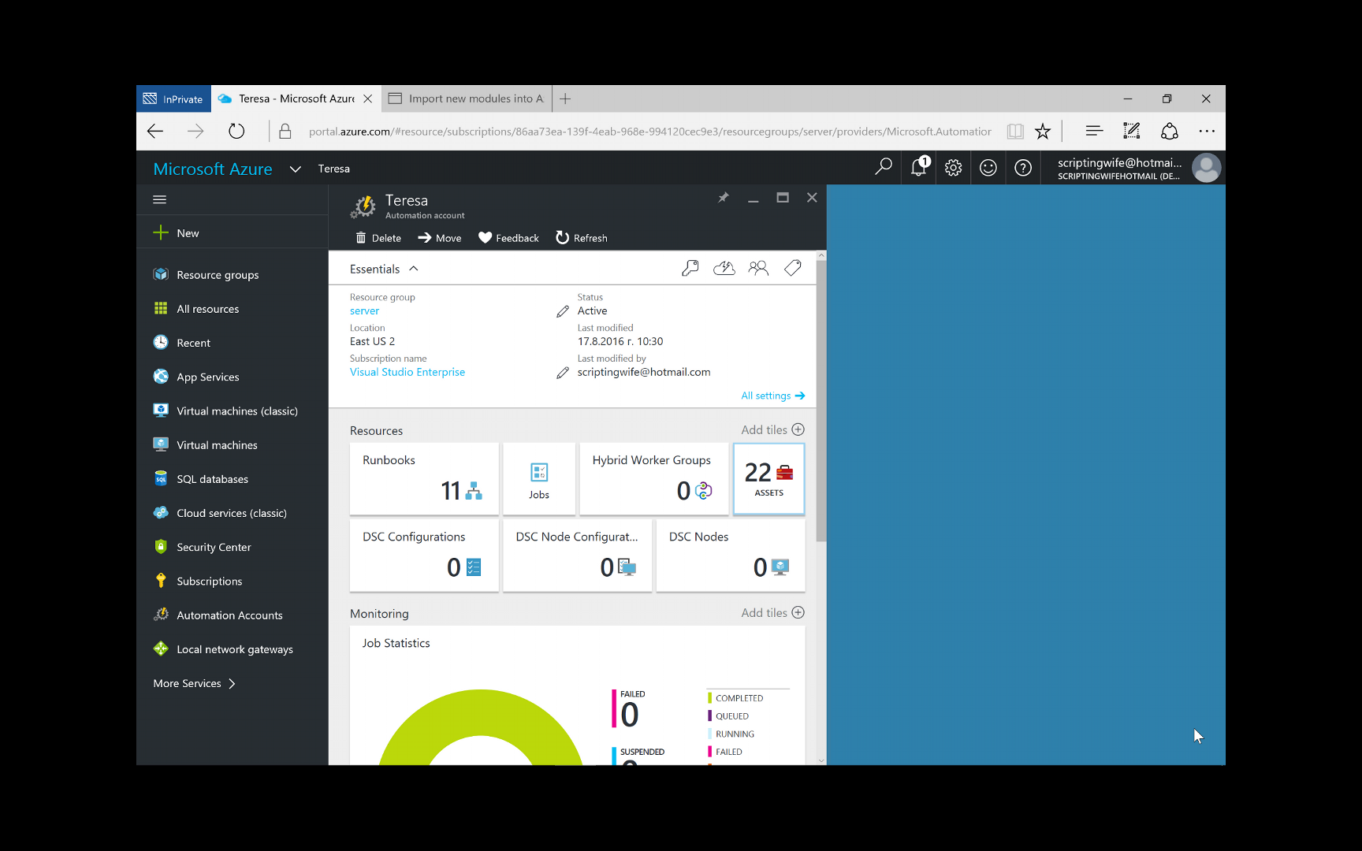
Browse Runbook Gallery
Notes:
DEMO: Browse the Runbook Gallery

Slide 12
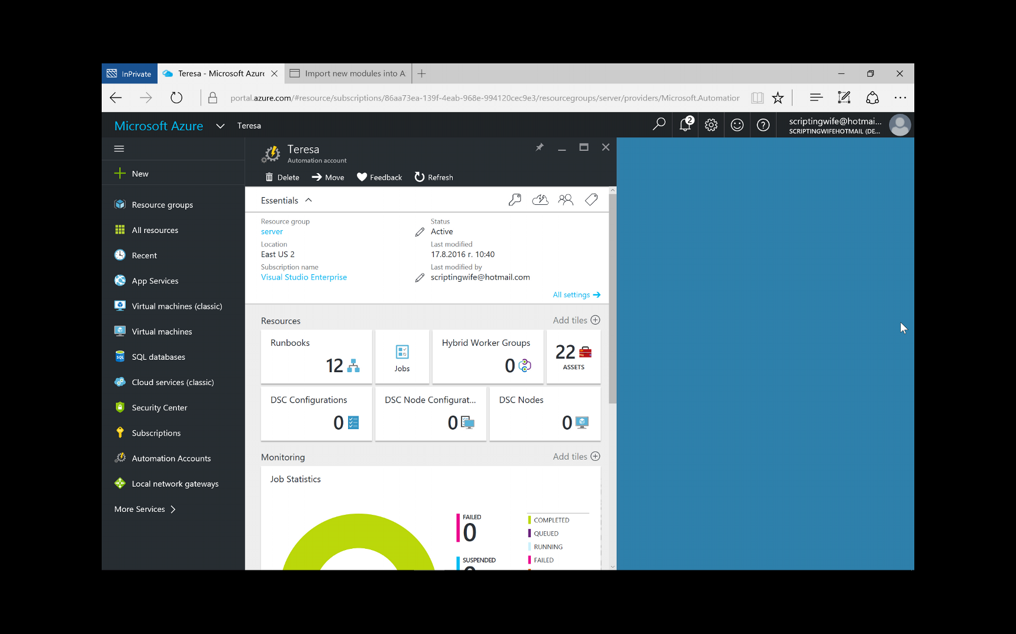
Import Module from Gallery
Notes:
DEMO: Import a module from the PowerShell Gallery

Slide 13
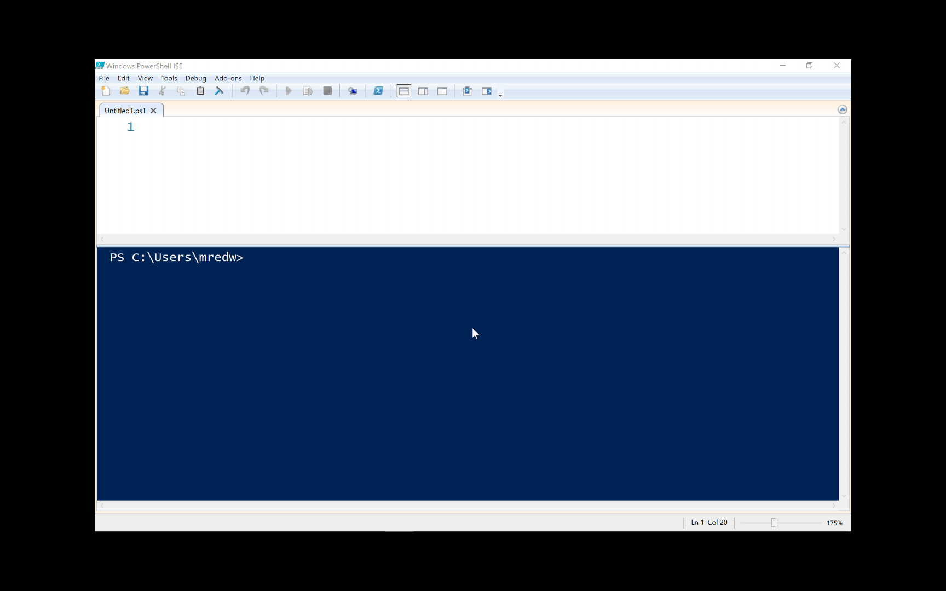
PowerShell ISE Add-On
Notes:
DEMO: Demo the PowerShell Automation ISE Add-On

Slide 14
Source Control
Uses GitHub
  Need GitHub account: Demo
  Need GitHub Project: Demo
Tie into Automation Source Control: Demo
Later adding Visual Studio Online
Notes:
DEMO: Three demo’s illustrating setting up and configuring Source Control

Slide 15
Downsides to only using Runbooks
Have to write TEST, SET, REPORT logic
Have to schedule execution to happen continually
Have to open inbound ports on all machines to manage
Have to give Automation inbound access to all machines to manage
Can’t easily grok configuration requirements just by skimming
Can’t easily grok changes to configuration requirements by diffing different versions over time
Have to write imperative PowerShell even though really just trying to define a declarative “desired state”

Slide 16
Azure Automation DSC
Notes:
Ed

Slide 17
PowerShell Desired State Configuration: Overview
Notes:
Ed

Slide 18
PS DSC configuration management
Simplifies configuration
Prevents configuration drift
Flexible deployment options
Enables continuous deployment
Development
Test
Production
Notes:
Ed

Slide 19
Configuration and Continuous Deployment
Intent | Environment Configuration (Dev -> Test -> Production) | $SiteName = “TestWebApp” $SitePath = “d:\inetpub\testsite” Servers = 3 …
 | Structural Configuration | Website IIS { Ensure = "Present“ Name = $SiteName Path = $SitePath } …
Make It So | Idempotent Automation | foreach -parallel ($featureName in $Name) { $feature = Get-WindowsFeature -Name $featureName if(($Ensure -eq "Present") -and (!$feature.Installed)) { Install-WindowsFeature -Name $featureName } …. } …
Notes:
Ed

Slide 20
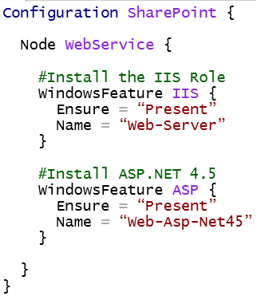

PowerShell DSC Lifecycle
Configuration
.MOF config document
Node
Compiled
Applied To:
WebService
Via Push
or Pull
Notes:
Ed

Slide 21
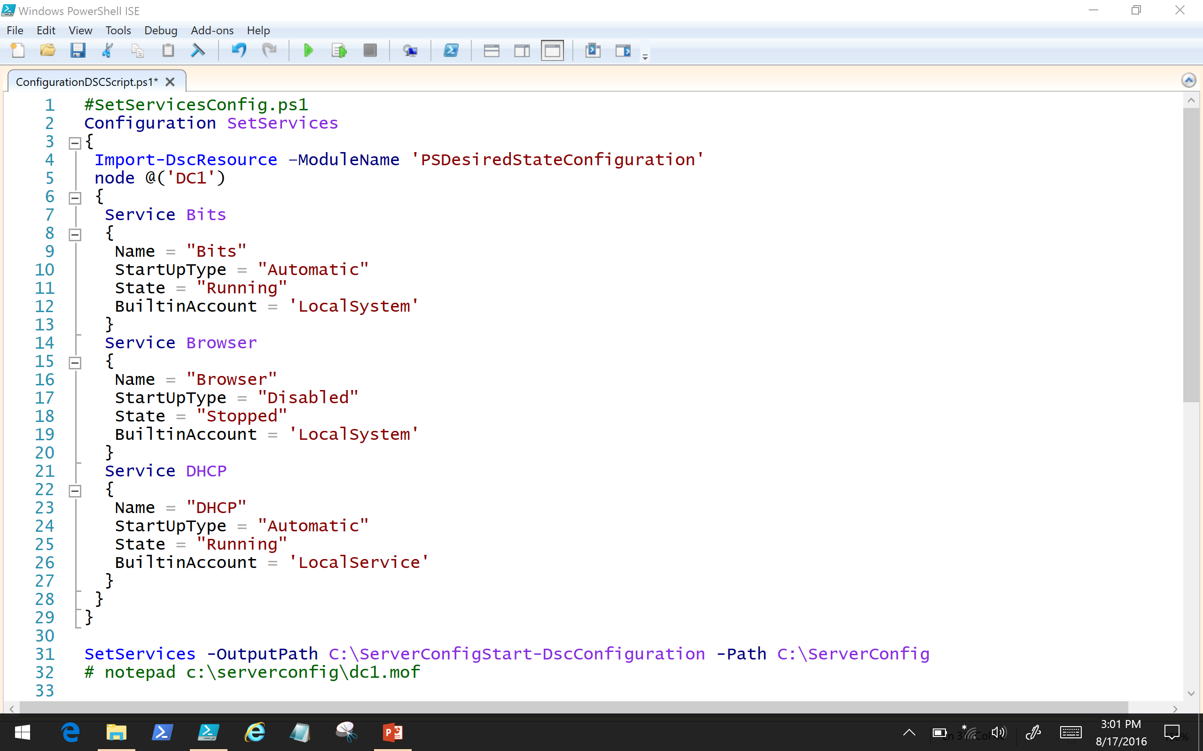
PowerShell DSC
Notes:
Ed

Slide 22
Can PowerShell DSC be used at enterprise scale?
Notes:
Joe

Slide 23
Using PS DSC requires management of lots of items
Configuration
Node Configurations
(.MOF config document)
Nodes
Compiled
Applied To:
WebService
Via Push
or Pull
1…N of these per
configuration
(+ checksum files for each)
1…N of these per
node configuration
1…N of these
Notes:
Joe

Slide 24
Not manageable at scale
How do I limit access?
  Which users can create / edit which configurations? Which users can compile which configurations (to create node configurations), and apply these node configurations to nodes?
  What nodes map to what node configurations? How do I prevent malicious nodes from accessing others?
How do I track change / compliance across my environments?
  Who edited what configurations when? Who compiled what configurations, to generate which node configurations, when?
  What nodes are compliant or not, pending changes, or failed to become compliant? What specifically is each not compliant with? What services and roles are overall in compliance or not?
How do I orchestrate configuration changes without impacting uptime?
  How do I make sure to only cause configuration changes during maintenance windows?
  How do I manage configuration changes across upgrade domains within a service?
  How do I manage configuration change dependencies across nodes in a service?
Notes:
Joe

Slide 25

Azure Automation DSC
PS DSC pull / reporting service hosted in the cloud
  Manage physical hosts and VMs in any cloud or on-premises
  Windows or Linux
Part of the Azure Automation service
PS DSC configuration, node configuration, node, and resource management
  Import
  Authoring
  Compiling
  Versioning
  Distribution to nodes
  Reporting
  Easy node onboarding
Notes:
Joe

Slide 26
Azure Automation DSC
Staging
Authoring
MOF
MOF
Configuration
(script)
Node Configuration
(MOF)
Reports
checksum
Rest Endpoint
DSC
Resources
Zip
Zip
Zip
Azure
Automation
Azure VM
Physical server
On-prem
VM
Notes:
Joe
Note that AA handles to deploy to pull server process. No more dealing with config ids, checksum, etc

Slide 27
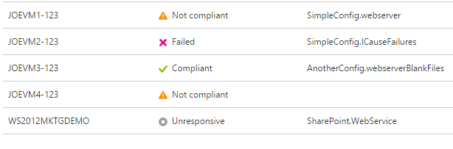
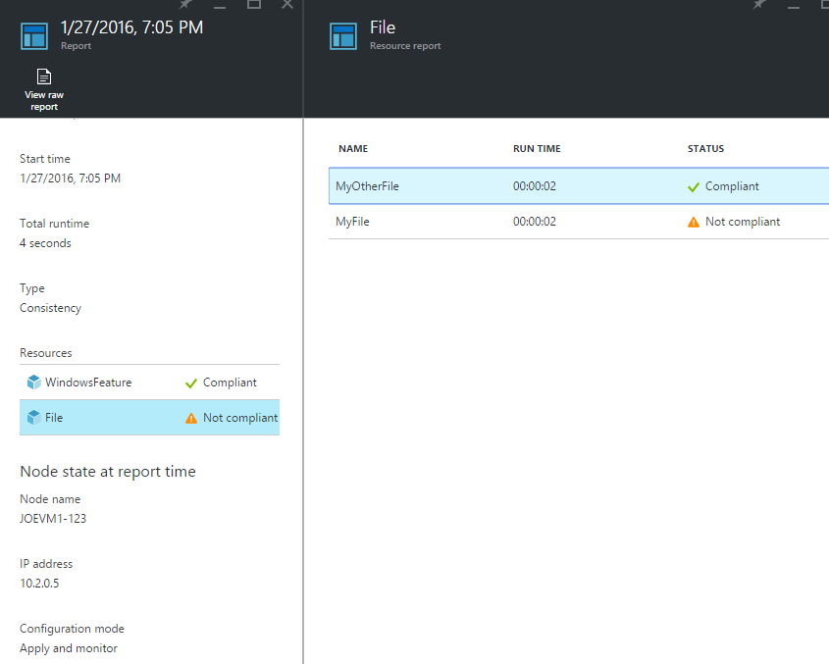
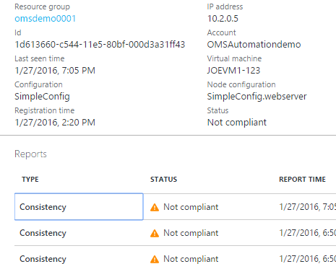
Azure Automation DSC
generally available
  Free tier: Up to 5 managed DSC nodes per subscription
  Basic tier: Unlimited managed DSC nodes, $6 / node / month, prorated daily
Features:
  Reliability improvements
  Improved reporting
  Support for report-only endpoint
  Azure VM Scale Sets support
Notes:
Joe

Slide 28
Azure Automation Resource Tree
Bold = DSC support
Runbook
  Job
Asset
  Module
    DSC Resource
  Credential
  Connection
  Schedule
  Variable
  Certificate
DSC Configuration
  Compilation job
    Node Configuration
      Nodes
Notes:
Joe

Slide 29
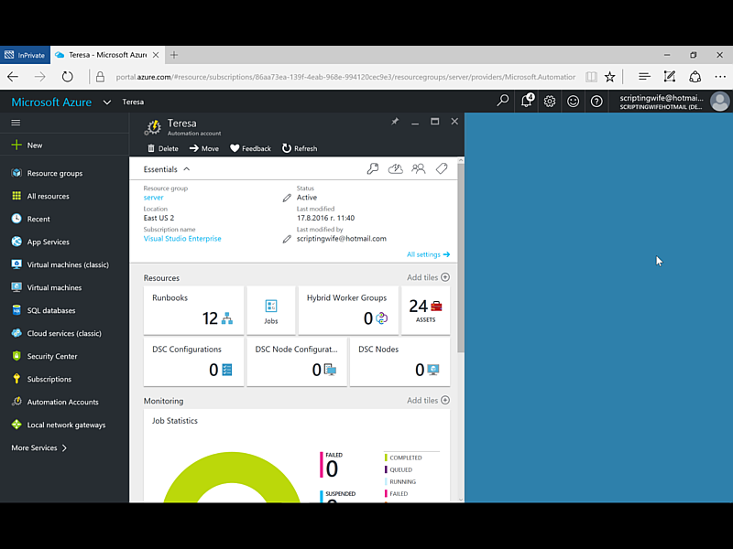
Configuring Automation DSC
Notes:
DEMO: Azure Automation DSC

Slide 30
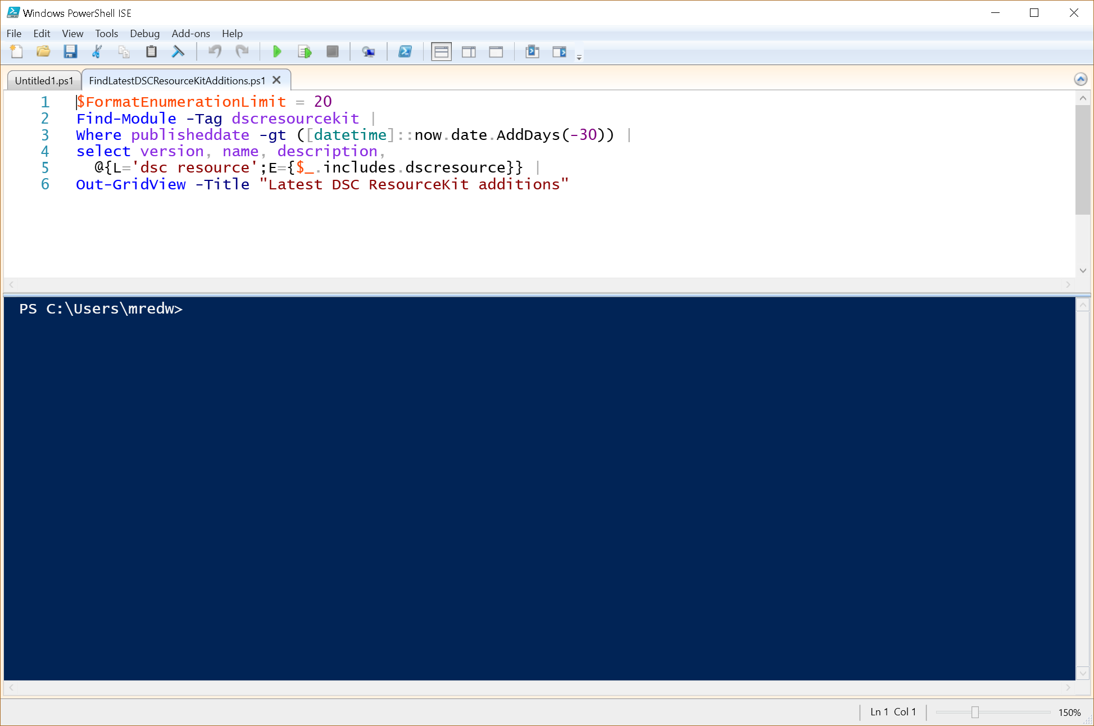
Finding new DSC Resources

Slide 31
DSC and Runbooks – better together
Use PS DSC to declaratively configure VMs / physical hosts
Use runbooks to orchestrate complex processes across systems
Use PS DSC within Azure Automation runbooks to configure machines as part of larger processes
  Ex: The multi-step process of deploying new DSC configurations to production servers:
    Monitor source control for new commits to DSC repository of an organization
    When new commit, store the DSC in Azure Automation DSC, set up to be pulled by the stage environment VMs
    Run test suite to confirm service in stage environment is functioning properly
    If tests fail, alert developers
    If tests pass, wait for maintenance window and then set up the DSC in Azure Automation to be pulled by production VMs, in a way that maintains service availability
Notes:
Joe

Slide 32
Azure Resource Manager templates vs DSC
Use PS DSC to declaratively configure VMs / physical hosts
Use ARM templates to declaratively configure cloud resources
- Create Azure VMs
- Create Azure Networks
- Create Az Storage accounts
- Create Az Automation accounts
- Create Azure VMs configured to use Automation DSC for configuration management
Notes:
Joe

Slide 33
Onboarding Linux/On-Prem
Notes:
Ed

Slide 34
Requirements for DSC for Linux
Required package | Description | Minimum version
Glibc | GNU C Library | 2.4 - 31.30
python | Python | 2.4 - 3.4
omi | Open Management Infrastructure | 1.0.8-4
openssl | OpenSSL Libraries | 0.9.8e or 1.0
python-ctypes | Python CTypes library | Must match Python version
libcurl | cURL http client library | 7.15.1
unzip | De-archiver for .zip files like resource modules | n/a
dsc-1.1.1.packages.tar.gz | PowerShell DSC | 1.1.1

Slide 35
Installing PowerShell DSC for Linux
sudo apt-get -y Glibc
sudo apt-get -y python
sudo apt-get -y omi
sudo apt-get -y openssl
sudo apt-get -y python-ctypes
sudo apt-get -y libcurl
sudo apt-get -y unzip
mkdir /Downloads
cd /Downloads
sudo curl -O https://github.com/Microsoft/PowerShell-DSC-for-Linux/releases/download/v1.1.1-70/dsc-1.1.1.packages.tar.gz
sudo tar -xzvf dsc-1.1.1.packages.tar.gz ; mv ./dsc/* ./ ; make ; make reg
You will also need an omiserver startup script as well.

Slide 36
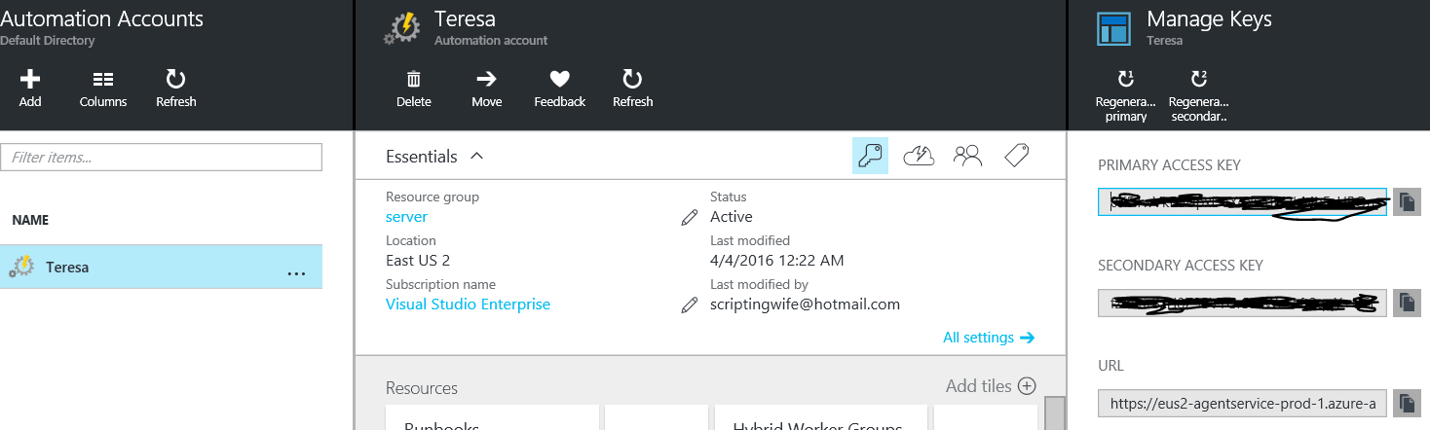
Use Register.py to onboard
Configures to pull from Azure Automation DSC
Configures to report to Azure Automation DSC
/opt/microsoft/dsc/Scripts/Register.py <Automation account registration key> <Automation account registration URL>

Slide 37
Azure DSC Gotachas
Node Configurations (MOFs), not Configurations, are what should be assigned to nodes in Automation DSC
Node Configurations (MOFs) are namespaced by configuration name in Automation DSC (ex: MyConfiguration.webserver)
Only machines with WMF 5 installed can communicate with Automation DSC
Automation DSC does not currently support composite configurations or partial configurations (but does support composite resources)
Currently, nodes must be reregistered with Automation DSC after one year, due to certificate expiration
Compiling Configurations that use credentials in Automation DSC requires passing in ConfigurationData via PS cmdlets
Notes:
Joe

Slide 38
In Review
Session Objective(s):
Provide an overview of Azure Automation
Demonstrate heterogeneous IT management using PowerShell and PowerShell DSC in Azure Automation
Key Takeaways
Azure Automation provides PowerShell as a Service -- a central, secure location for all your PowerShell assets, executions, and reports, that is scalable, reliable and highly-available
  Azure Automation DSC provides a reliable, highly-available, scalable DSC pull and reporting service that can be used to deliver, monitor, and update infrastructure aligned with IT rules
  Azure Automation simplifies automation and configuration across clouds, platforms, and datacenters
Notes:
Ed

Slide 39
Join the Monthly Automation calls
If interested, see us later to be added to the monthly invite.
Notes:
Eamon

Slide 40
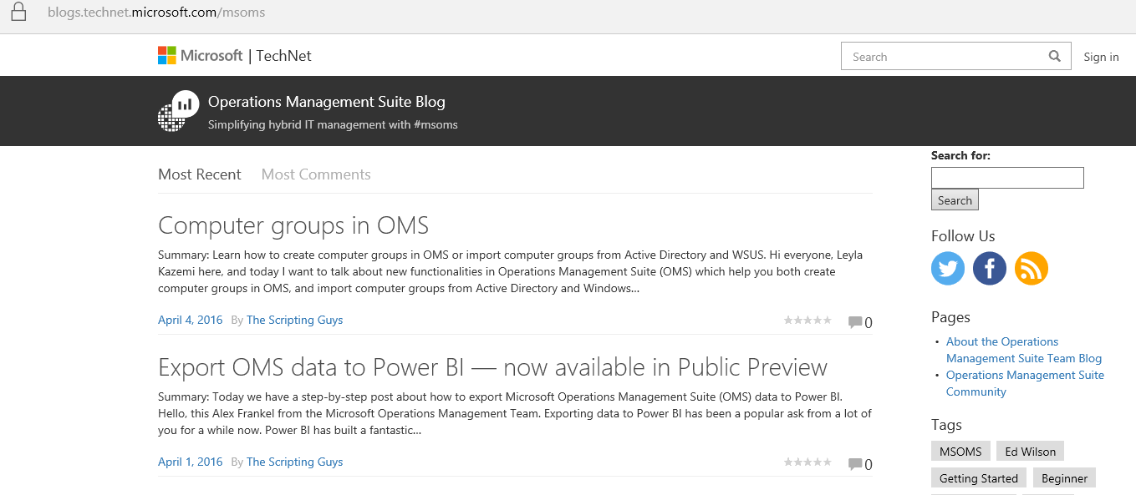
OMS Team blog
Http://aka.ms/omsblog

Slide 41
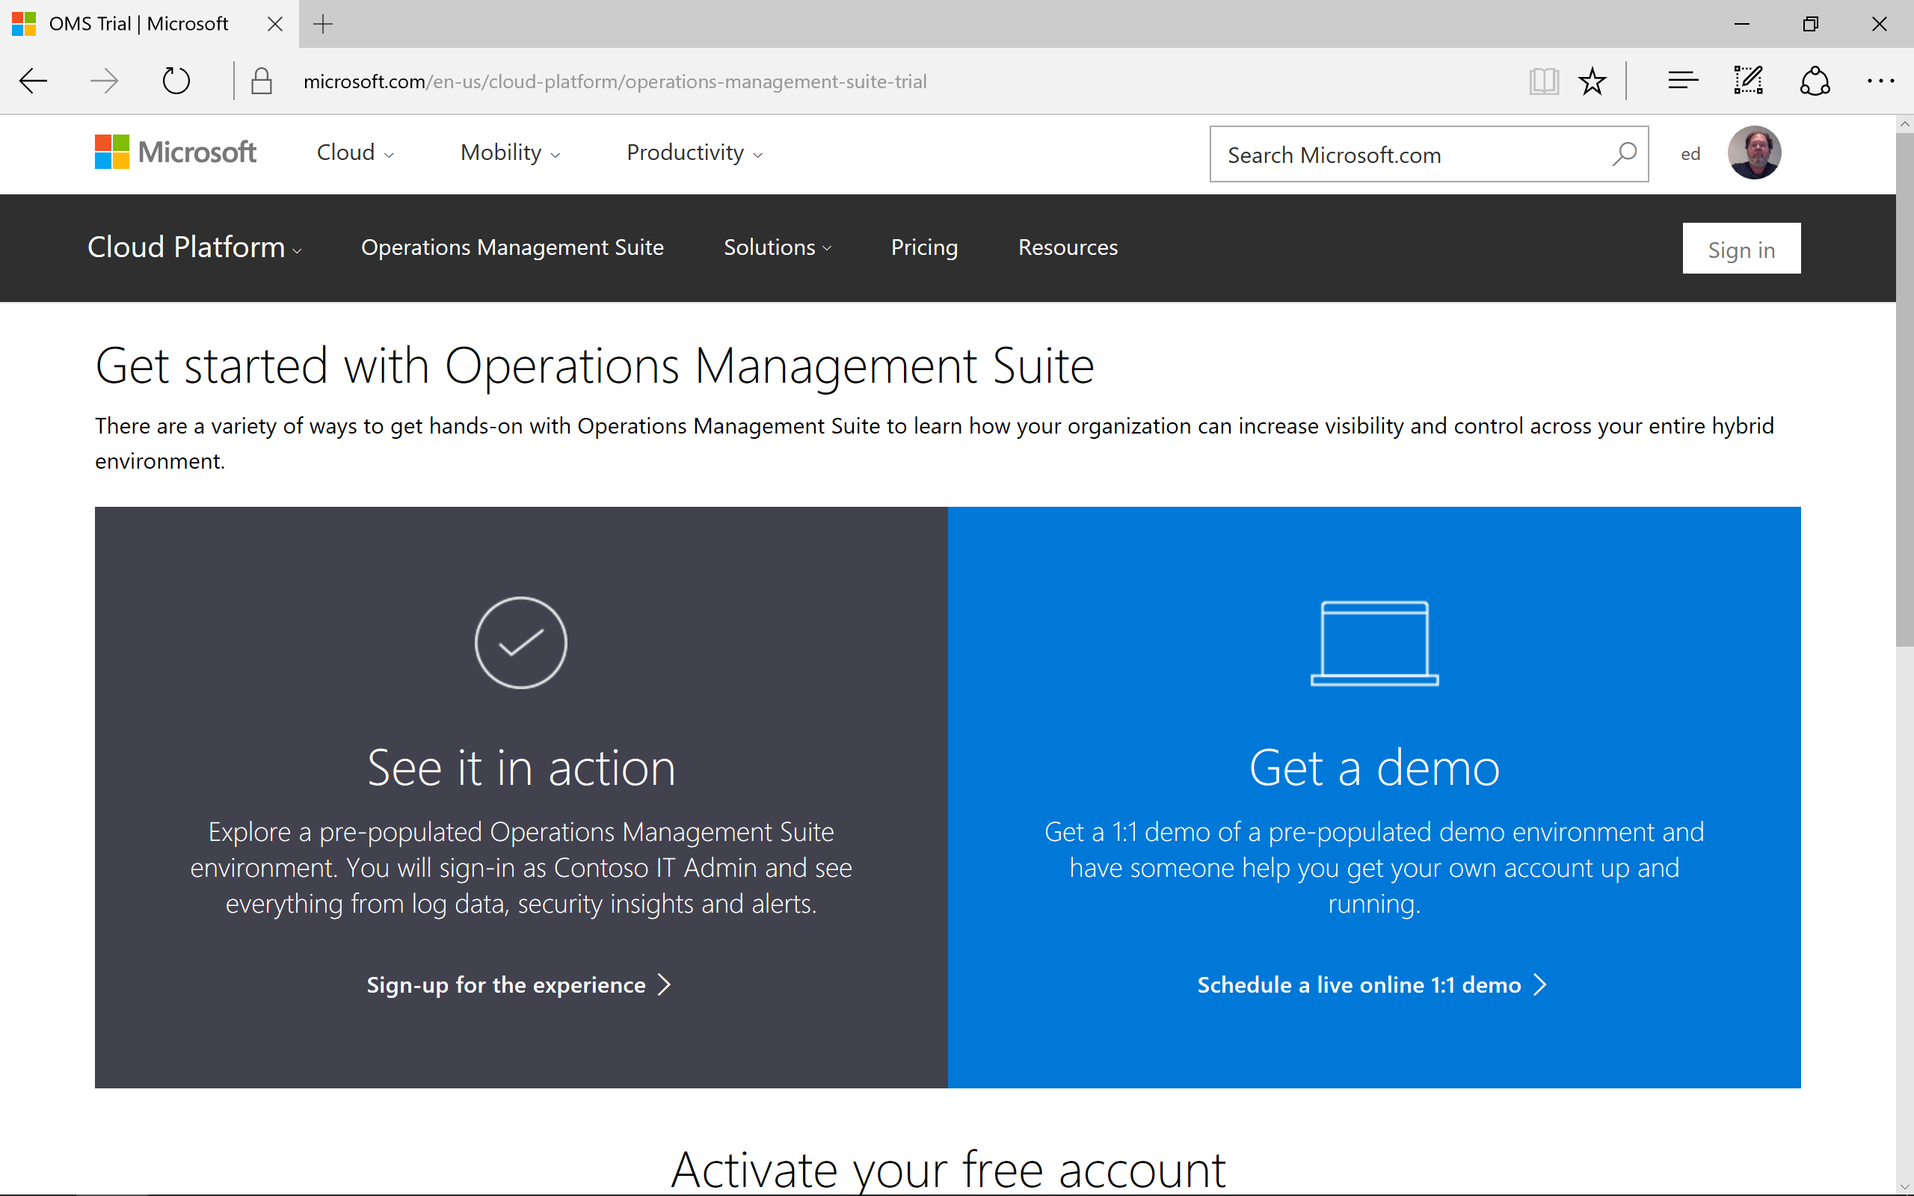
Try OMS
Http:/Aka.ms/getoms

Slide 42
PowerShell
Open Source
Notes:
Created by Neema Saeedi (neemas) for presentation to Microsoft IT, Service Deployment and Operations Team
Notes attached to slides.
Additional Resources mentioned:
PowerShell Gallery - https://www.powershellgallery.com/
WMF 5.0 Preview April 2015 - http://www.microsoft.com/en-us/download/details.aspx?id=46889

Slide 43
PowerShell Sustained Investment
2006: PowerShell v1 → 2016: PowerShell v5
  WMF provides downlevel support
  Windows not has over 3000 cmdlets
  Not just a shell: task-based scripting language
  Desired State Configuration
  Pester
  Moving beyond Windows:
    PowerShell Gallery
    Azure Automation

Slide 44
What’s going on
Availability of PowerShell on Linux and Mac
  Ubuntu 14.04/16.04
  CentOS 7.1
  RHEL 7
  Mac OS X 10.11
We’re open sourcing Windows PowerShell (.NET) and PowerShell Core (.NET Core)
  Single codebase for Windows and *nix editions
  Alpha / developer preview builds w/ community support
  One repository: https://github.com/PowerShell/PowerShell
  MIT License

Slide 45
PowerShell Core enables heterogeneous management
  Azure, AWS, VMWare, Chef
  OpenSSH (including PSRP support)
PowerShell and Microsoft are good citizens in a Linux world
  Easy to wrap native Linux binaries (crontab, Python)
  Templatizing configuration files (Apache)
  Editor Services working with multiple editors (VS Code, Sublime Text)
PowerShell is cool and unique
  Structured data as objects
  REALLY easy to wrap native Linux binaries that output JSON (journalctl)
  Awesome as a REST shell

